Slide 1



Make your own video game. In two days.
Hack Club Haven Tashkent | 14-15 November | Free | Ages 13-18
Notes:
Say who you are in one line. Then go straight to the game.

Slide 2


Hi! We are students, just like you.
Not teachers. Not a company. A team of Tashkent teenagers running a game jam in our city.

Slide 3

Play this.
This game was made by a teenager from Tashkent - as a beginner.
Want a turn?
Notes:
Open the game on the projector BEFORE this slide. Let one student play for 60 seconds. Do not talk over it.

Slide 4
What is Hack Club?
A nonprofit from the USA that helps teenagers build real things with code. Run by teens, for teens.
100,000+
teenagers
1,500+
school clubs
Free
always
hackclub.com

Slide 5
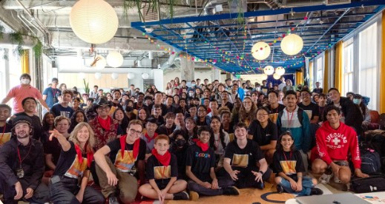
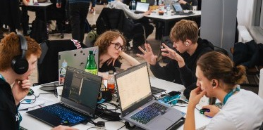
What is Haven?
200+ cities. One weekend.
Teenagers around the world make video games on the same weekend. Tashkent is one of those cities - for the first time.
14-15 November
Ages 13-18
No experience needed

Slide 6
How the weekend works
1
2
3
4
Saturday morning
Before lunch
Then
Sunday
We all build a first game together, step by step.
Everyone publishes their game online.
Make your own game - alone or with friends.
Play everyone's games. Certificates.

Slide 7

What you take home
Your own game online, with a link to share
An international certificate
Hack Club merch for everyone who finishes a game
Free food both days
New friends who like the same things

Slide 8
"But..."
"I can't code."
Perfect. We learn together in the first hour.
"I don't know anyone."
Bring your friends. You'll be on one team.
"Is this for me?"
If you play games, draw, make music or are just curious: yes.
Notes:
Answer the three fears before anyone asks them.

Slide 9
For your parents
Adults supervise the whole weekend
No overnight: everyone goes home each evening
Parents sign a consent form
Hack Club has a written safety policy: hackclub.com/safeguarding-policy

Slide 10

Sign up now.
It takes one minute. Do it now, not later.
haven.hackclub.com/tashkent
Notes:
Stand and wait while they scan. Do not move on. Never say "later".

Slide 11
Questions?
tashkent@haven.hackclub.com
Want to be the Haven ambassador at your school? Talk to us after class.
Two days. One game. See you there.
Notes:
Take names of anyone who wants to be an ambassador.

